Slide 1
grid2demand: an open-source package to generate zone-to-zone travel demand
Output
Processing
Inputs
(bf-processing
Inputs
(sources)
Data Sources
Demand
Gravity Model
(Auto, Bike, Pedestrian)
Node
Node
osm2gmns
…
Must include zone_id
Zone
census blocks
Zone
TAZs from agencies
…
Optional
Zone-to-Zone
(OD Demand)
POI
POI
osm2gmns
Agent
trip rate file
…
Package Core Engine

Slide 2
Current Scenarios Based on Our Meeting (Pls edit the PPT if I misunderstand)

Slide 3
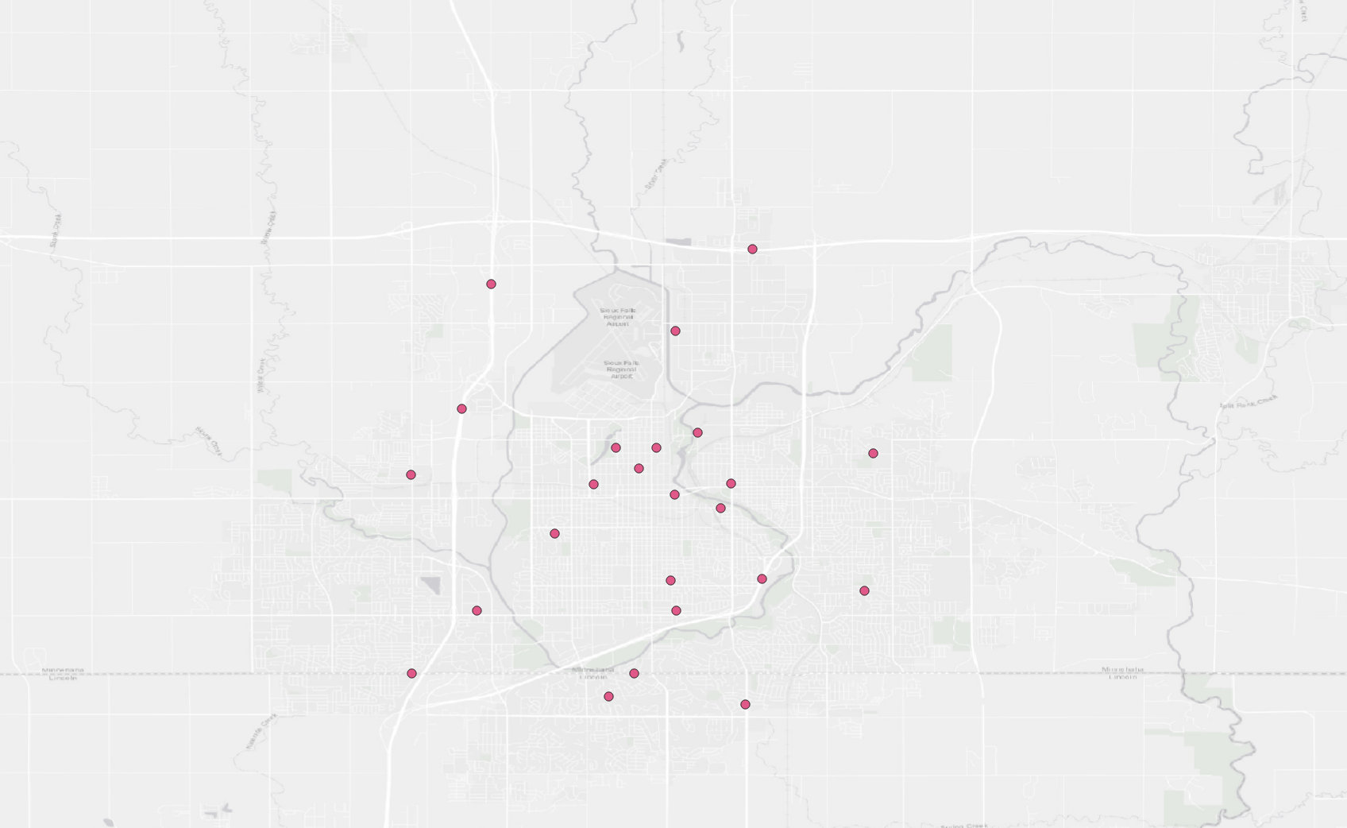
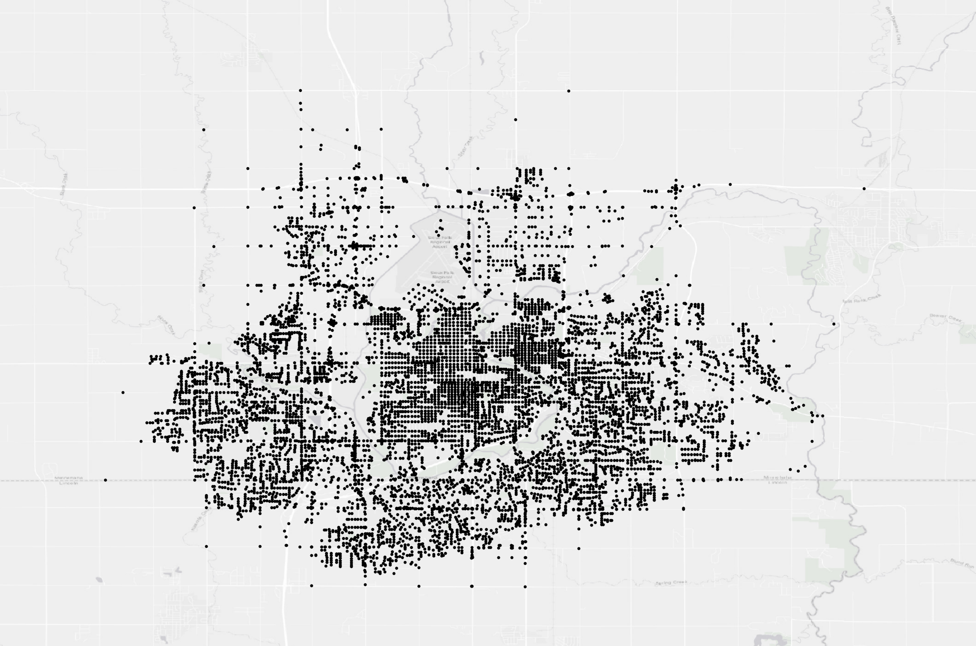
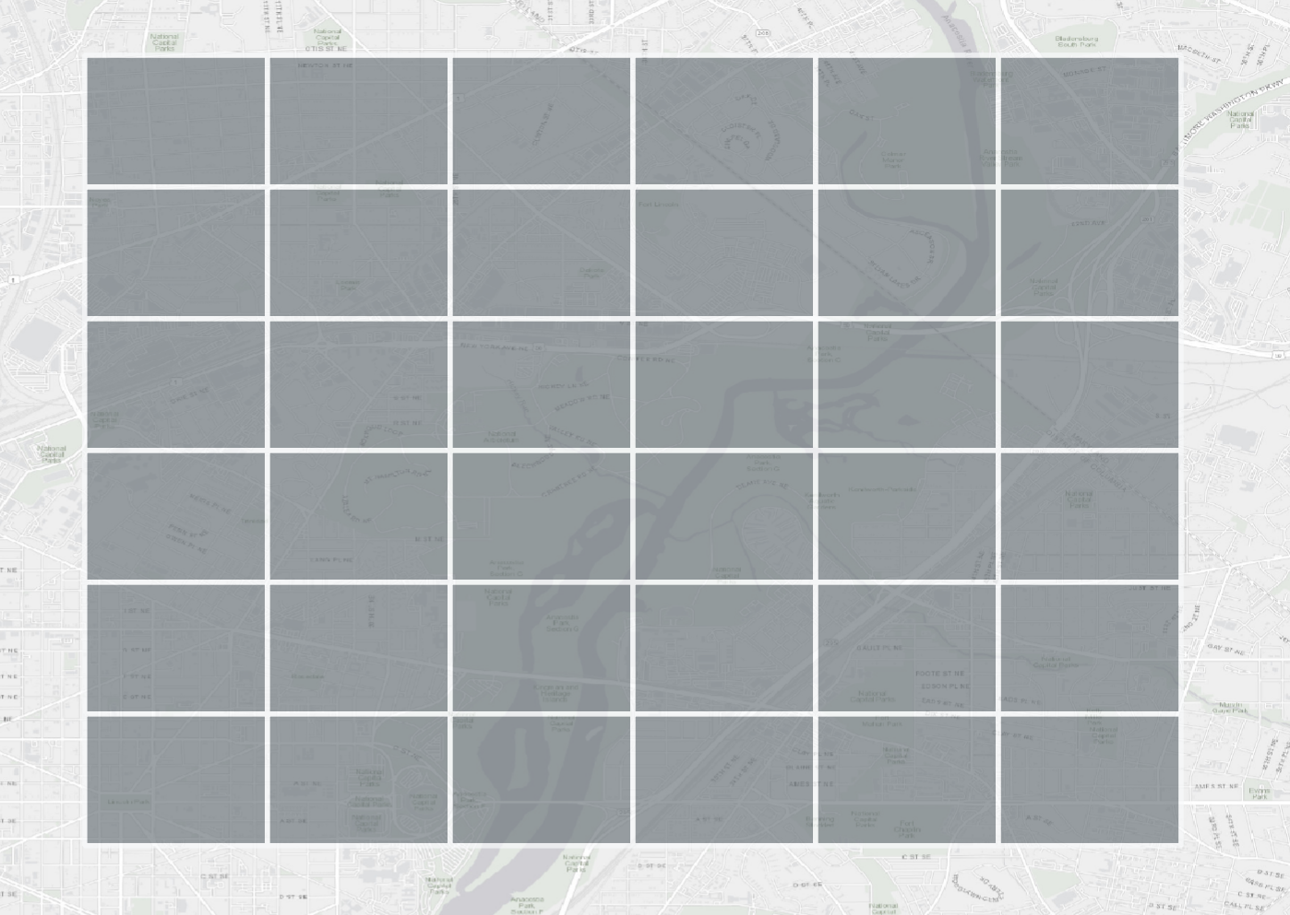
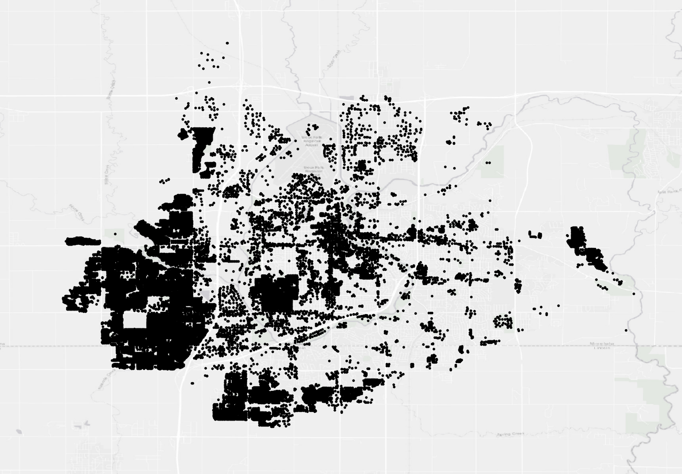
grid2demand: a tool to generate zone-to-zone travel demand
Scenario New1 (use zone_id in node as zone): Inputs are node and poi
Output
Processing
Inputs
(bf-processing
Inputs
(sources)
Extract nodes from
zone_id in Node
(Activity nodes)
Demand
Gravity Model
Node
Node
Create Grids from Node
Zone
Zone-to-Zone
(OD Demand)
POI
POI
Agent
Package Core Engine

Slide 4
grid2demand: a tool to generate zone-to-zone travel demand
Scenario New1 (use zone_id in node as zone): Inputs are node and poi
(Run in Show/Display mode)
Output
Processing
Inputs
(bf-processing
Inputs
(sources)
Extract nodes from
zone_id in Node
(Activity nodes)
Demand
Gravity Model
Node
Node
Create Grids from Node
Zone
Zone-to-Zone
(OD Demand)
POI
POI
Agent
Package Core Engine

Slide 5
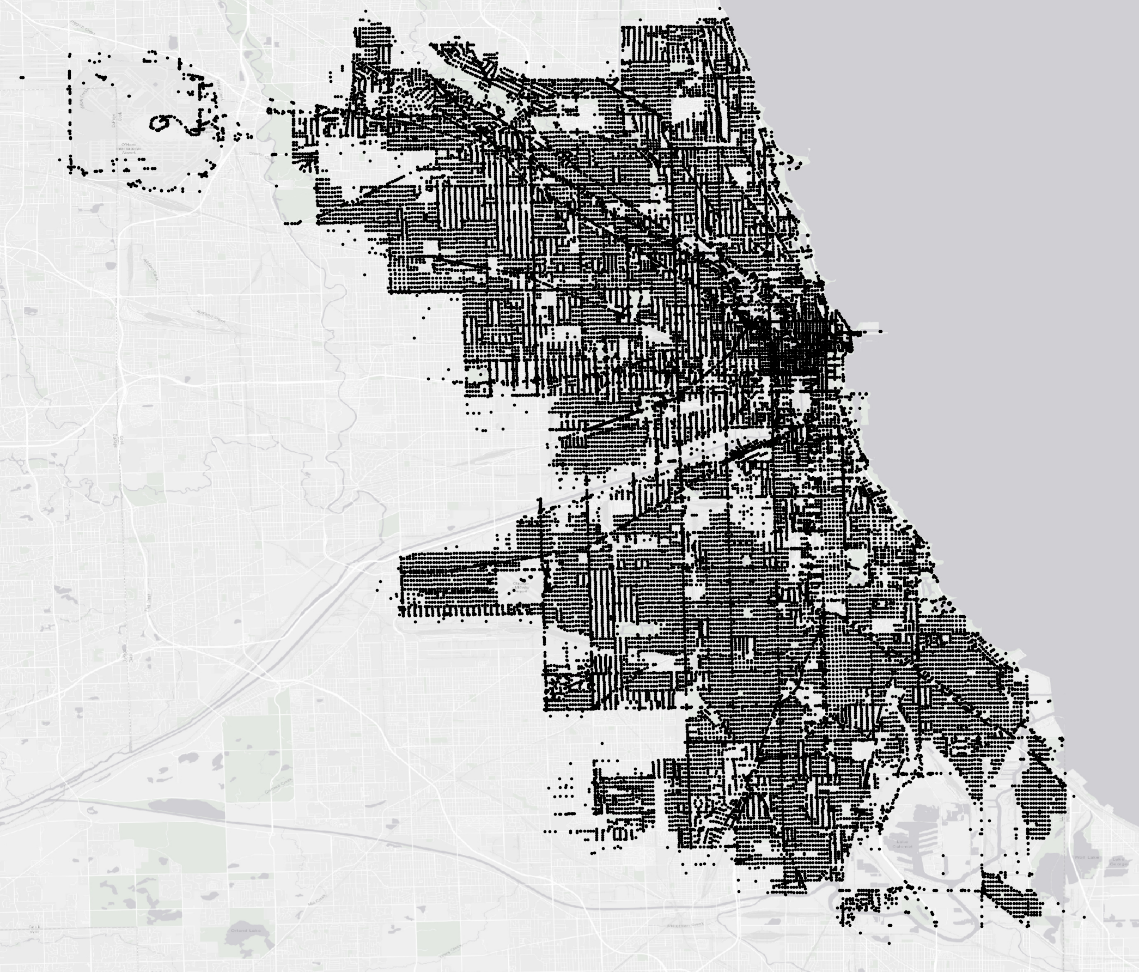
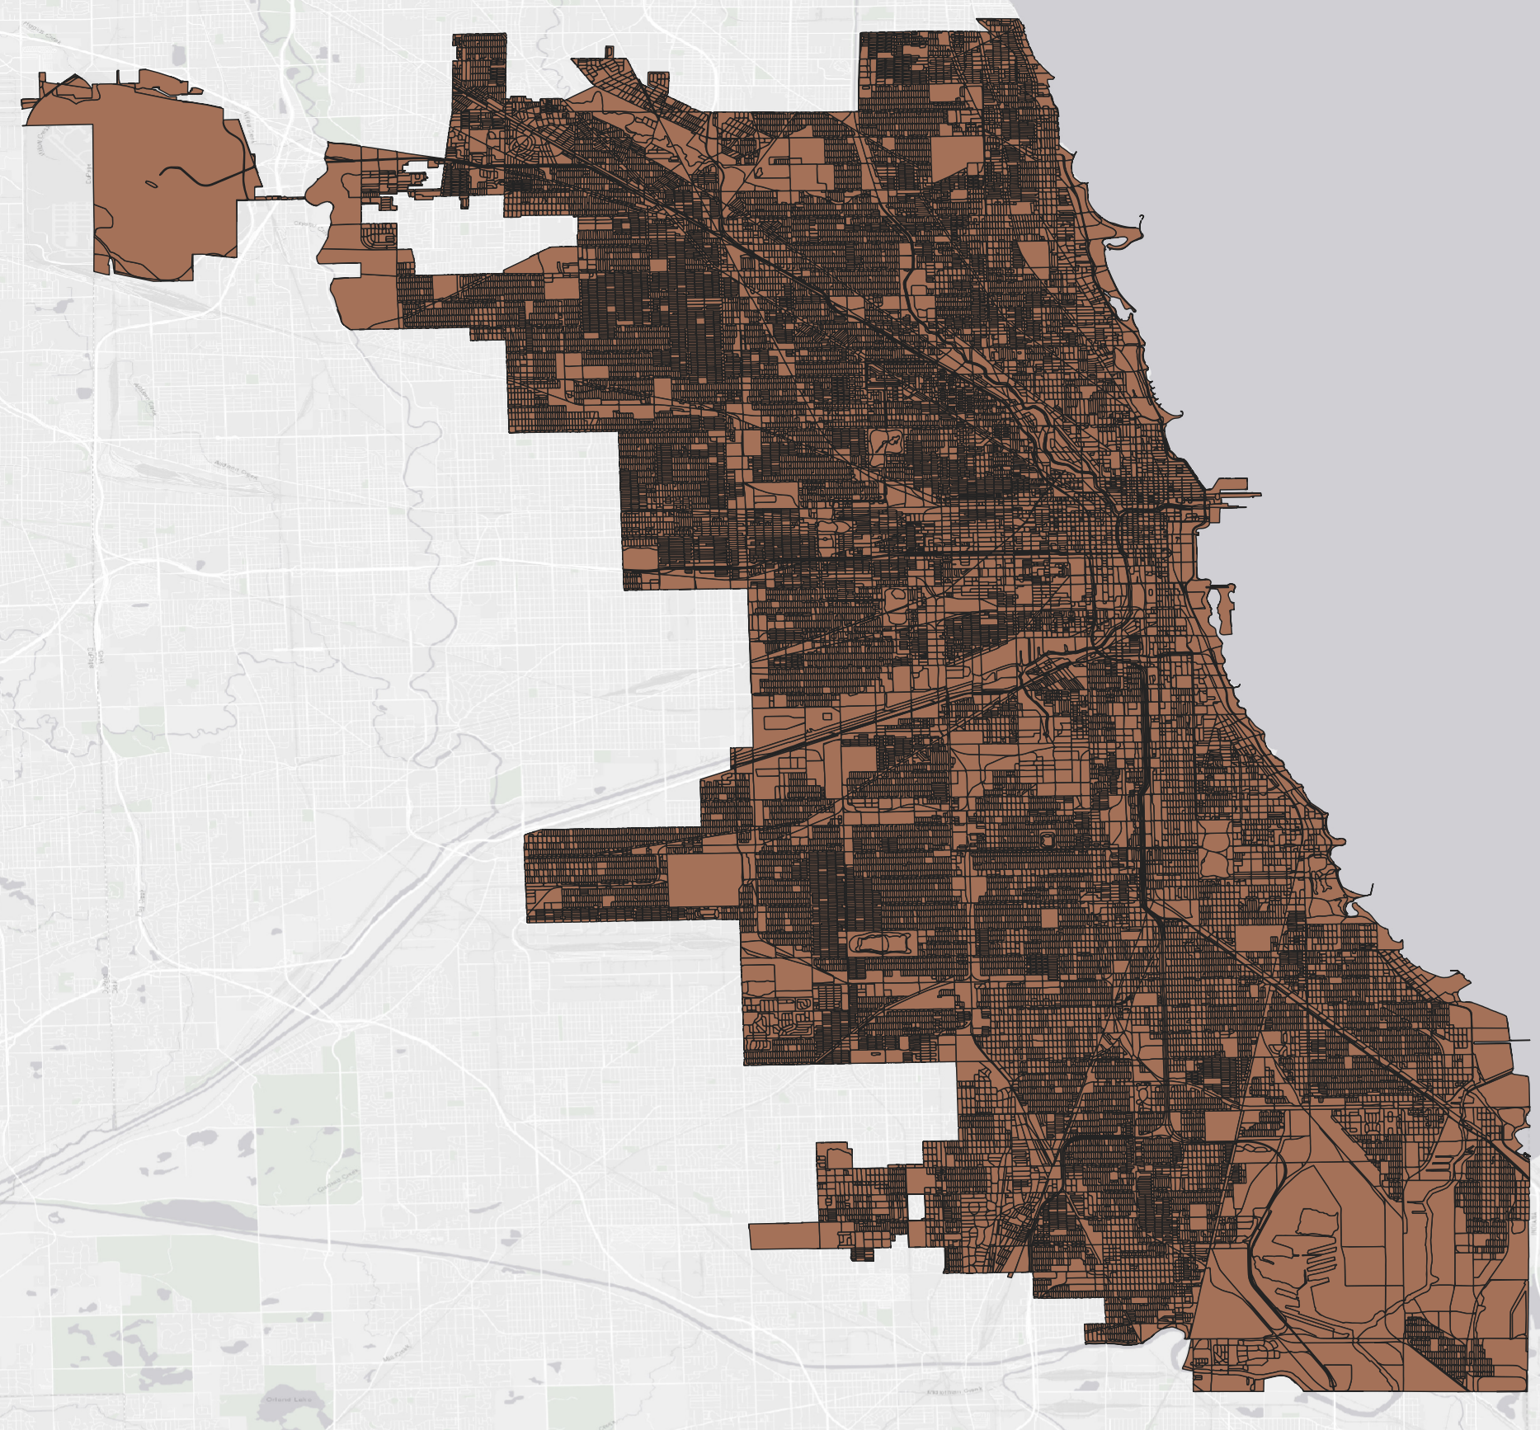
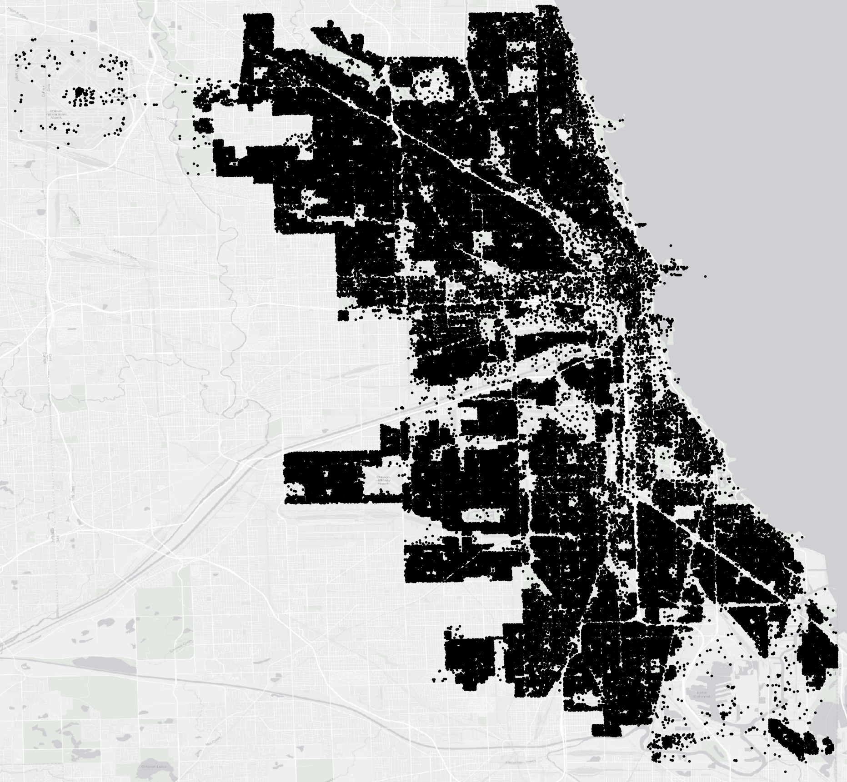
grid2demand: a tool to generate zone-to-zone travel demand
Scenario 3 (use external zones from TAZs): Inputs are node and poi
Output
Processing
Inputs
(bf-processing
Inputs
(sources)
Demand
Gravity Model
Node
Node
Zone
Zone
census blocks
Zone-to-Zone
(OD Demand)
POI
POI
Agent
Package Core Engine

Slide 6
Previous / Existing Scenarios

Slide 7
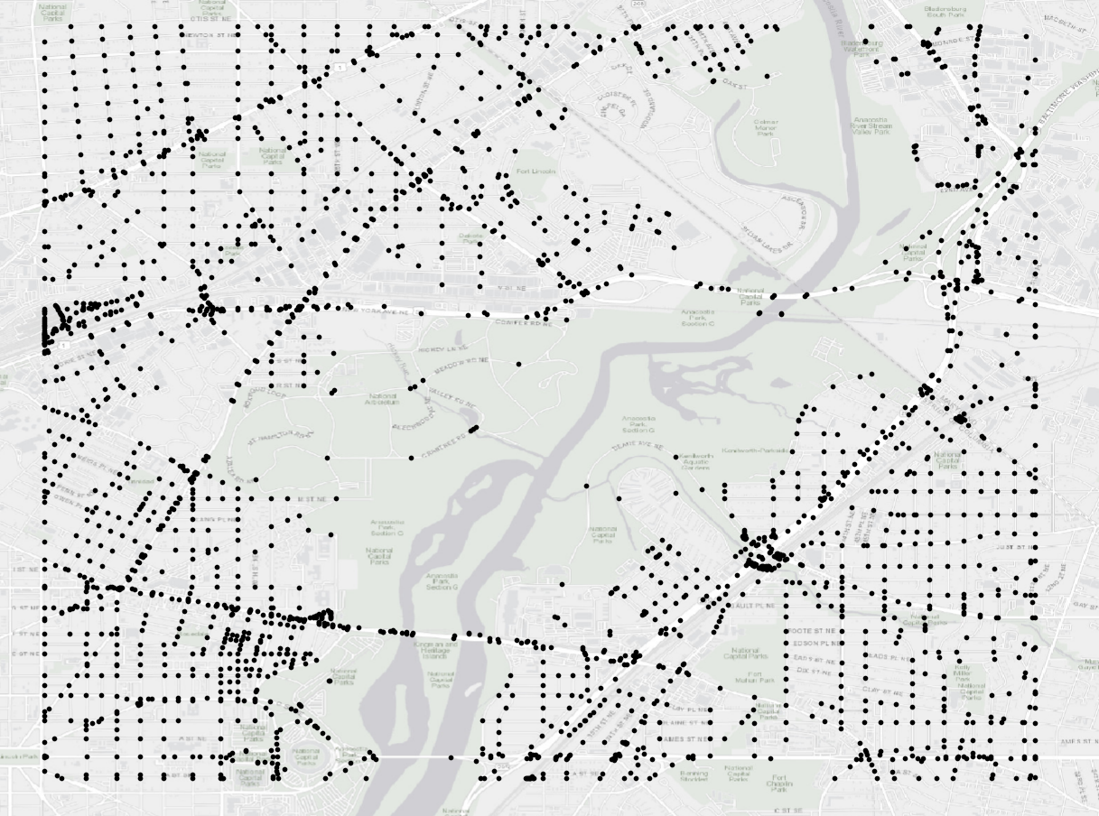
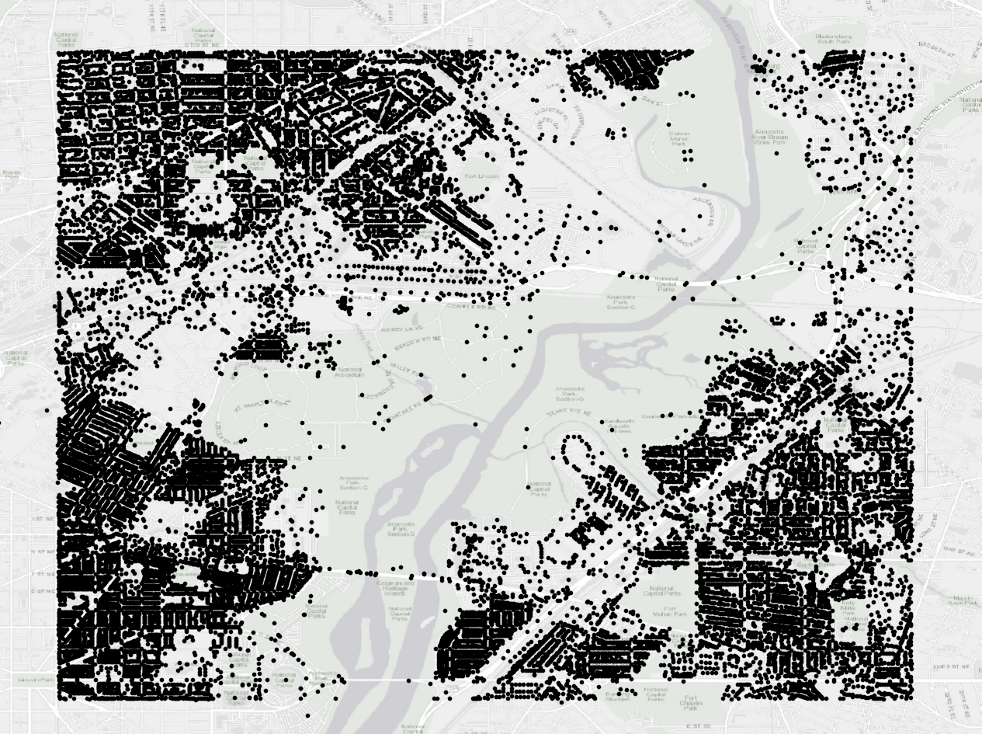
grid2demand: a tool to generate zone-to-zone travel demand
Scenario 1 (create grid zones): Inputs are node and poi
Output
Processing
Inputs
(bf-processing
Inputs
(sources)
Demand
Gravity Model
Node
Node
Without zone_id
Create Grids from Node
Zone
Zone-to-Zone
(OD Demand)
POI
POI
Agent
Package Core Engine

Slide 8
grid2demand: a tool to generate zone-to-zone travel demand
Scenario 2 (use zone_id in node as zone): Inputs are node and poi
Output
Processing
Inputs
(bf-processing
Inputs
(sources)
Demand
Gravity Model
Node
Node
With zone_id
Extract zone_id from node as zone
for zone-zone demands
Zone
Zone-to-Zone
(OD Demand)
POI
POI
Agent
Package Core Engine

Slide 9
grid2demand: a tool to generate zone-to-zone travel demand
Scenario 3 (use external zones from TAZs): Inputs are node and poi
Output
Processing
Inputs
(bf-processing
Inputs
(sources)
Demand
Gravity Model
Node
Node
Zone
Zone
census blocks
Zone-to-Zone
(OD Demand)
POI
POI
Agent
Package Core Engine

